Slide 1
Fusion Gene Visualizer
BIOT670 //Group 1a: Nana Anguah Dei, Lynn Do-Trang, Mary Friedman, Sam Freund, & Joanna Harris

Slide 2
Scope of Project
Introduction
Design viewer for fusion gene transcripts from .bam file
Tool would be helpful for analyzing sequence data related to pediatric cancers
Display reference fusion partner genes in alignment with fusion gene sequencing read order
Allow continuous view of read sequence and breakpoint identification
Create a general user interface (GUI) for the user to import a .bam file for analysis
Divided project into three main parts:
Initial Research
.bam processing
GUI development
Spliced Reference Sequence
Fusion Partner 1
Fusion Partner 2

Slide 3
Initial Research
existing tools
Our initial research helped in identifying existing tools for fusion gene visualization, as well as tools which might be useful for constructing a fusion gene visualizer from scratch.
Existing tools for fusion gene visualization
Clinker
INTEGRATE-Vis
FGviewer
Existing tools for .bam file manipulation and parsing
Samtools
Pybam
Existing tools for GUI design
Tkinter
PyQt
PySide2

Slide 4
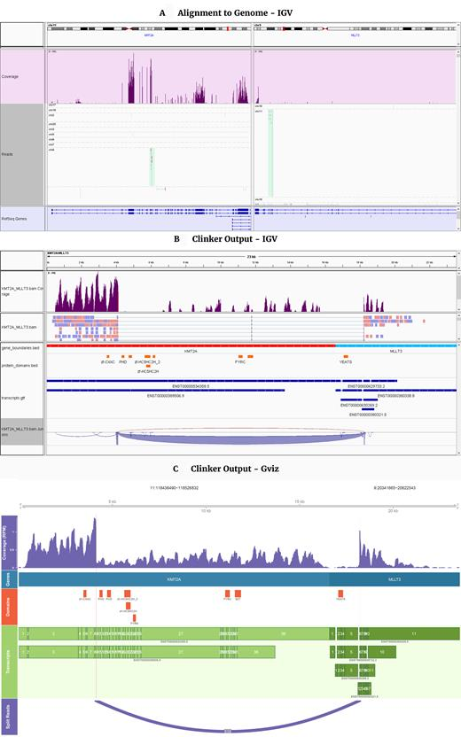
Initial Research
existing tools
Clinker
A visualization tool for exploring and plotting fusion genes discovered in RNA-seq data by Smidt et al. (2018).
https://github.com/Oshlack/Clinker/
Operating systems: 64 bit Linux or Mac OS X
Programming language: Python, R, Bash
Other requirements: STAR, Samtools and Gviz

Slide 5
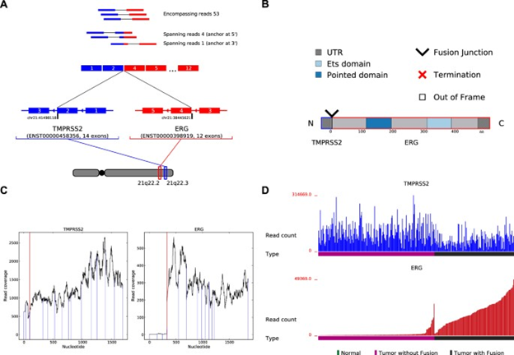
Initial Research
existing tools
INTEGRATE-Vis
A tool for comprehensive gene fusion visualization by Zhang et al. (2017)
https://github.com/ChrisMaherLab/INTEGRATE-Vis
Programming Language: Python version 2.7
Other Requirements: CMake, GCC, Matplotlib, and gtfToGenePred

Slide 6
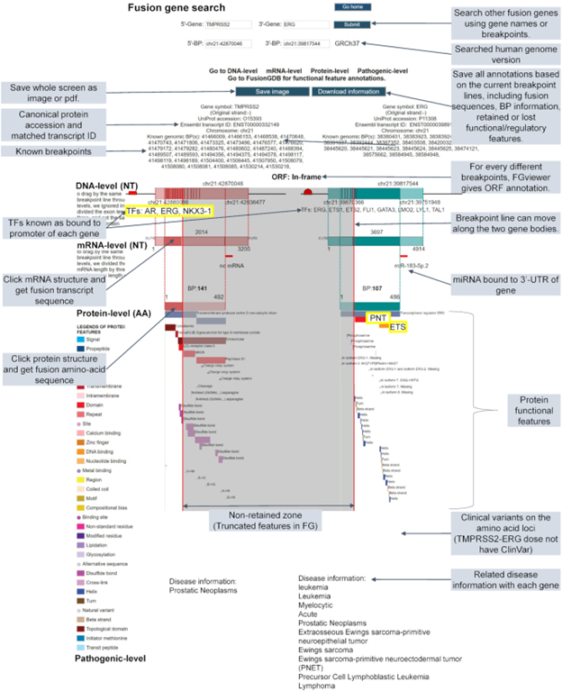
Initial Research
existing tools
FGViewer
An online visualization tool for functional features of human fusion genes by Kim et al. (2020)
https://www.ncbi.nlm.nih.gov/pmc/articles/PMC7319540/
Programming Language: Python Tornado web server and MySQL database

Slide 7
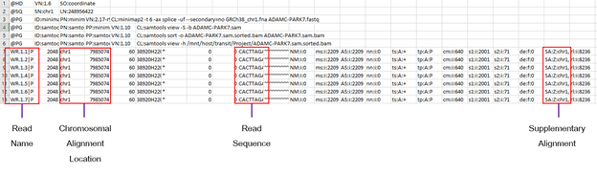
.bam processing
file breakdown
A BAM file is a compressed version of a SAM file. Thus, the sample BAM files provided to our group for this project had to be converted to SAM format for structure elucidation. This was done using a SAMtools, which has a variety of commands related to SAM and BAM files.
SAMTools
Written in C and runs on Unix, we used Anaconda’s (Python package management) Bioconda to install it
VIEW - to convert between SAM and BAM file types
SORT - to order the alignments based on their position relative to the reference sequence
Example of a VIEW command:
samtools view -h eg/ERR188273_chrX.bam > eg/ERR188273_chrX.sam
Once converted, the SAM file is viewable in notepad and/or excel, and columns containing relevant data can be identified.

Slide 8
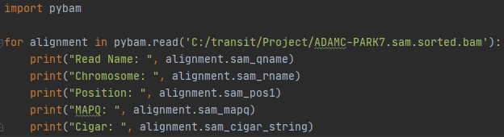
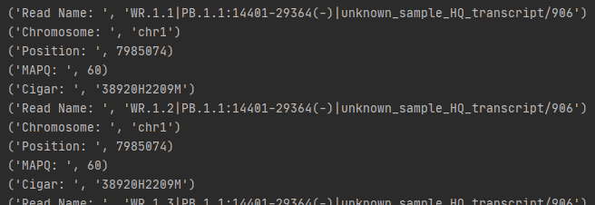
.bam processing
existing tools
PyBam is a python package with useful functions for SAM/BAM file parsing.
https://github.com/JohnLonginotto/pybam
Allows user to iterate over alignment records in a BAM file
for alignment in pybam.read('/my/data.bam'): ...
Allows for parsing of specific data elements for each read alignment
A few relevant examples include:
sam_qname: read name
sam_rname: chromosome
sam_pos1: position on chromosome
sam_mapq: mapping quality score
sam_cigar_string: cigar
sam_tags_string: TAGs for this alignment*
*The sam_tags_string data element is of particular interest for this project, as is contains supplementary alignment (SA) information. Reads with more than one high-scoring alignment are more likely to contain a fusion gene transcript. However, this BAM file column can contain numerous TAG types other than SA, so further parsing is needed to extract relevant data. (see example of TAGs column from BAM file below - SA data indicated in red)

Slide 9
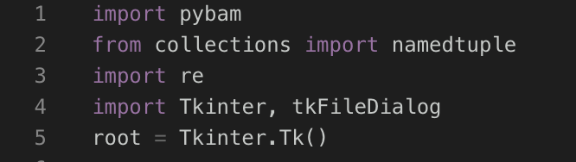
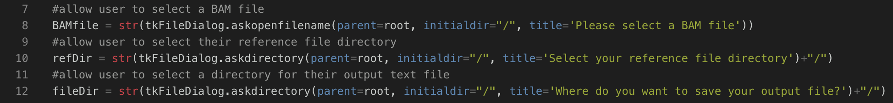
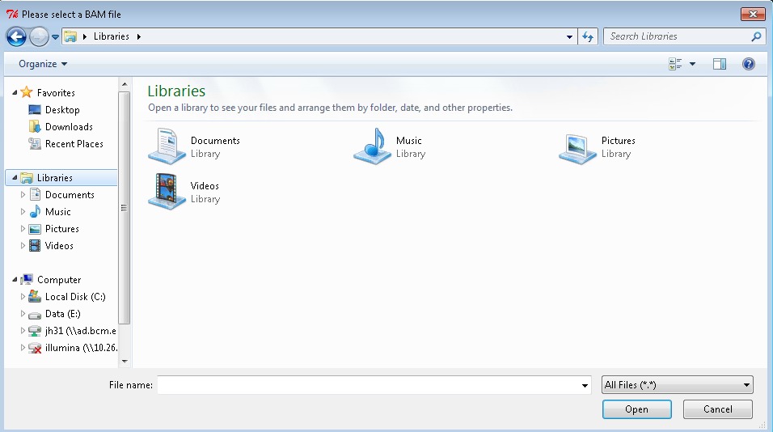
.bam processing
packages and user input
Pybam for BAM parsing
Namedtuple for storing read information
Regular Expression for further parsing
Tkinter for enhanced user prompts
Tkinter tkFileDialog.askopenfilename and tkFileDialog.askopendirectory provide an intuitive pop-up allowing the user to:
Select a BAM file for processing
Select their reference file directory
Select a location for the output text file

Slide 10
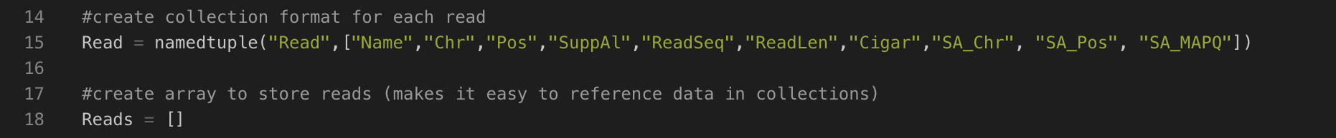
.bam processing
storage of alignment data
Named tuple structure created to store useful information related to each alignment
All information for each read is linked, rather than being stored in separate arrays or dictionaries
Each read tuple can then be appended to a single array, without the structure or naming being affected
Information can be called from the array using intuitive names established in tuple structure (Name, Chr, etc.)
Example of the contents of a single Read (Sequence omitted for brevity):

Slide 11
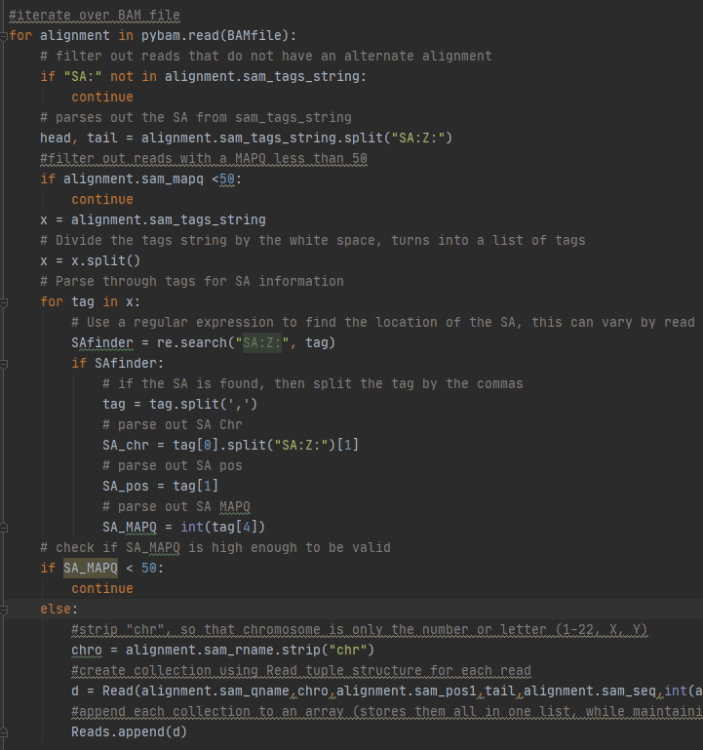
.bam processing
filtering and parsing
Filter reads by:
Presence of a Supplementary Alignment (SA)
A mapping quality score (MAPQ) > 50
Location of the “SA” tag in the Standard Tags list can vary depending on the presence or absence of other tags
Regular Expression is used to parse the SA into three separate parts: Chromsome, Position, and MAPQ
A filter can then be applied for SA MAPQ > 50
Before appending the chromosome to the read tuple, “chr” is stripped, leaving only the chromosome number or letter (1-22, X, or Y)
Allows for seamless retrieval of reference sequence later

Slide 12
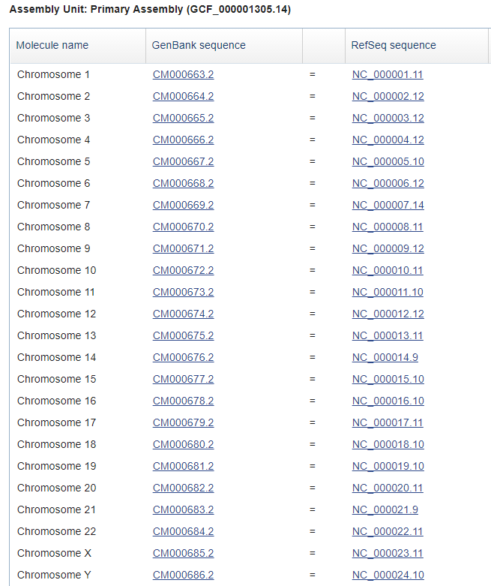
.bam processing
reference files
The final fusion gene viewer would ideally display the read sequence for each fusion partner along with their associated reference sequences. While the read sequence can be pulled from the BAM file, the reference sequence must be retrieved from an external file
With our company’s application in mind, we designed our BAM processing code to deal with reference files for human genomic reference Genome Reference Consortium Human Build 38 (GRCh38).
To begin, a user should download the GRCh38 FASTA chromosome references needed for their application. https://www.ncbi.nlm.nih.gov/assembly/GCF_000001405.26/
*If multiple references are needed, they should be stored in the same directory.

Slide 13
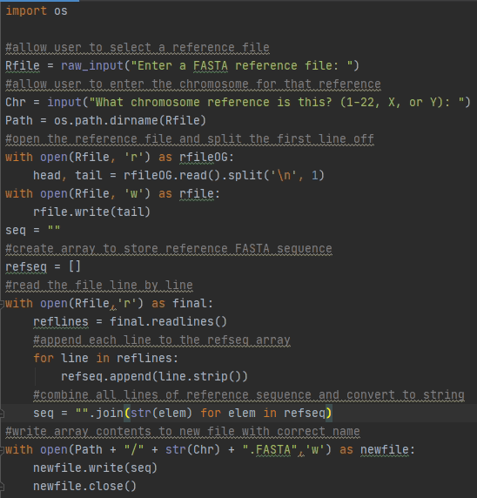
.bam processing
reference files
Our group created a code (ProcessRefFiles.py) to reformat FASTA chromosome references downloaded from NCBI.
Allows user to select a reference file
Header line is stripped
Newline characters are stripped
New file name is chromosome character only (1-22, X, Y)
Such alterations and the new naming convention allow for seamless reference sequence retrieval downstream. Also, this process only needs to be done once.
“Chromosome” stored for read alignment record can be used to point to the correct reference file
“Position” stored for read alignment record can be used to point to the correct location within the reference file

Slide 14
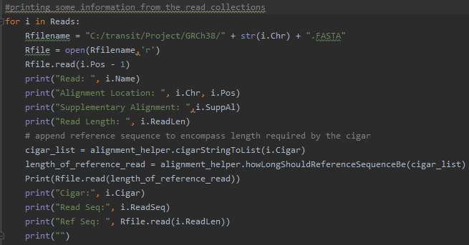
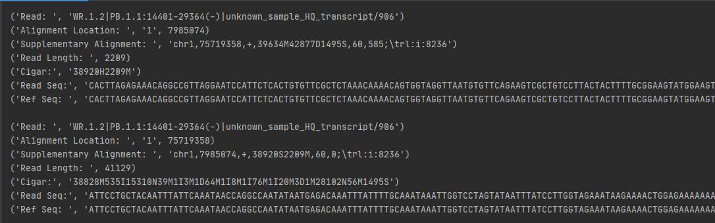
.bam processing
reference files
The BAM processing code will initially prompt the user to select a reference file directory.
For any particular read, the reference file will be defined based on the chromosome stored for that alignment record.
Rfilename = refDir + str(i.Chr) + “.FASTA”
Within the defined reference file, the starting point will be defined based on the position stored for that alignment read.
Rfile.read(i.Pos - 1)
The length of the reference sequence will be determined using a separate code (alignment_helper.py), which determines read length based on the alignment cigar string.

Slide 15
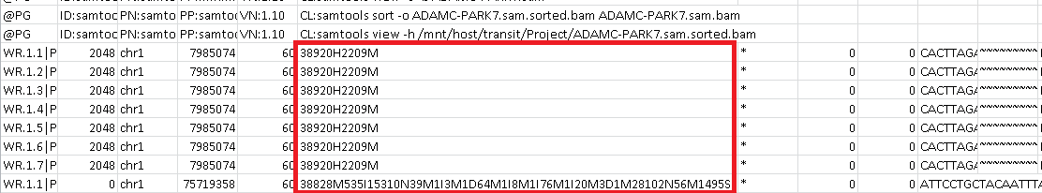
.bam processing
cigars
It is essential to consider the cigar string when attempting to visualize aligned read and reference sequences, as it accounts for events such as deletions and insertions. The shorthand for deciphering these strings is as follows:
M = match (does not necessarily indicate matching base pairs - just matching alignment)
D = deletion (gap in read sequence)
I = insertion (gap in the reference sequence)
S = soft clipping
H = hard clipping

Slide 16
.bam processing
cigars
Pybam parsing function sam_l_seq returns the length in base pairs of the read sequence stored in the BAM file for that alignment. While using this simple length to determine the reference sequence could conceivably work for a number of situations, there are many for which it would not. For example, the read sequence could contain deletion events, which would result in an increased character length during actual alignment. (see example below)
Read | A | T | G | - | - | C | C | A | T | G | 8bp | 10 characters
Reference | A | T | G | C | G | C | C | A |  |  | 8bp | 8 characters
In this example, the read sequence contains a total of 8 base pairs; however, there is a 2 base pair deletion. Thus, when the read and reference sequences are aligned 1 to 1, the character length of the read sequence becomes 10 base pairs rather than 8. Using the static length of 8 to pull the reference sequence would result in it being 2 base pairs short for alignment.

Slide 17
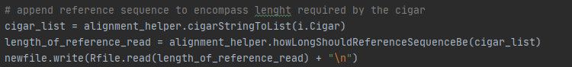
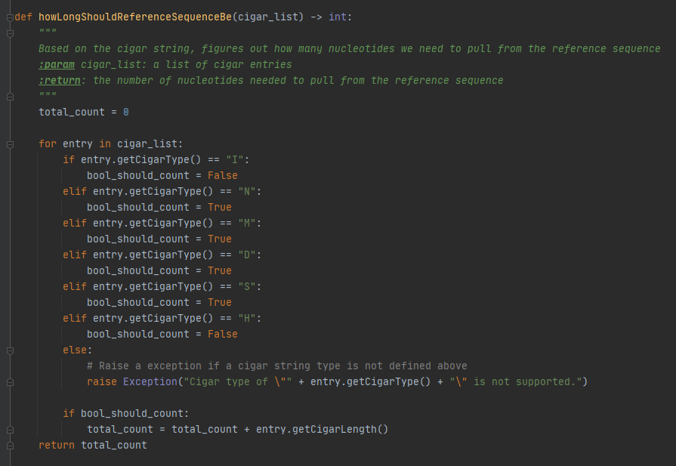
.bam processing
cigar -> read length
The length of the reference sequence is dependent on the CIGAR
The function howLongShouldReferenceSequenceBe() counts the number of nucleotides for relevant CIGARs
Match, Alignment gap, deletion event, and soft clip
It ignores hard clips and insertion events
By summing the relevant CIGAR events, the user can pull the full length of the relevant reference read sequence

Slide 18
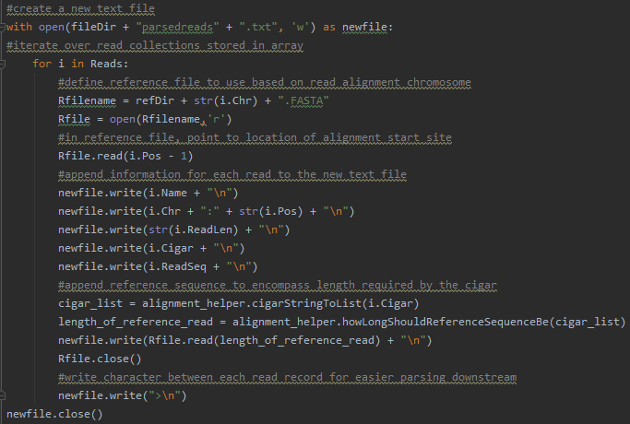
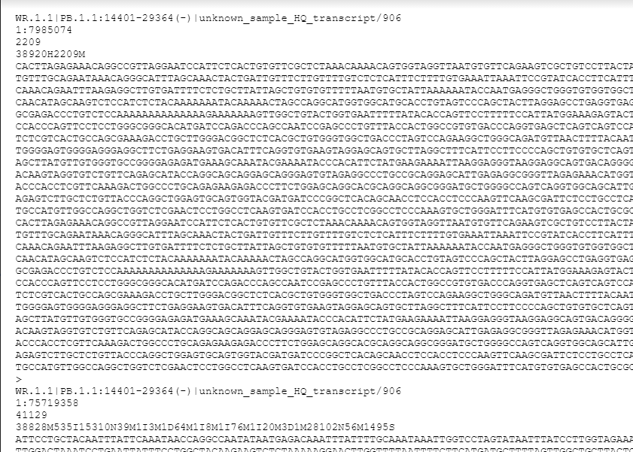
.bam processing
bridging the gap
The GUI for our fusion gene viewer is still under development. To bridge the gap between BAM processing and alignment viewing, a text file with sample data is generated, which can then be read by the alignment_tester.py code. (GUI code)
The sample data text file includes:
Read Name
Chromosome & Position
Read Length
Cigar String
Read Sequence
Reference Sequence
Other available informations which could be included if deemed useful:
SA Chromosome
SA Position
Notes:
Changes to top right screen shot

Slide 19
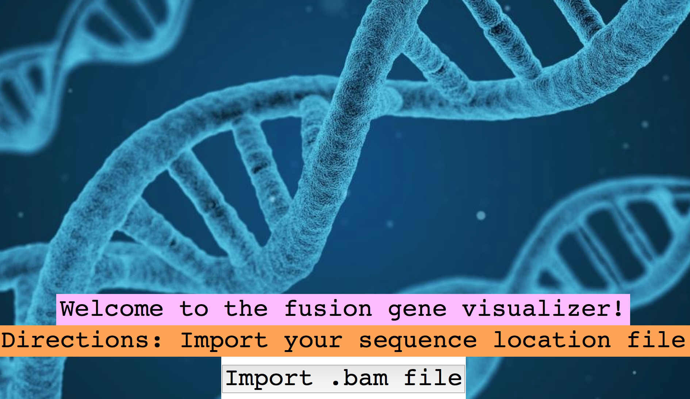
GUI Development
existing tools
Tkinter
Tkinter isa GUI framework that is built into Python standard library
functional and cross-platform
Start by using Python’s built-in IDLE editor then used Spyder
Proposed Layout:
import button
welcome message
Directions
Link to Code:
https://github.com/srfreund/BIOT670/blob/master/Fusion%20Gene%20GUI

Slide 20
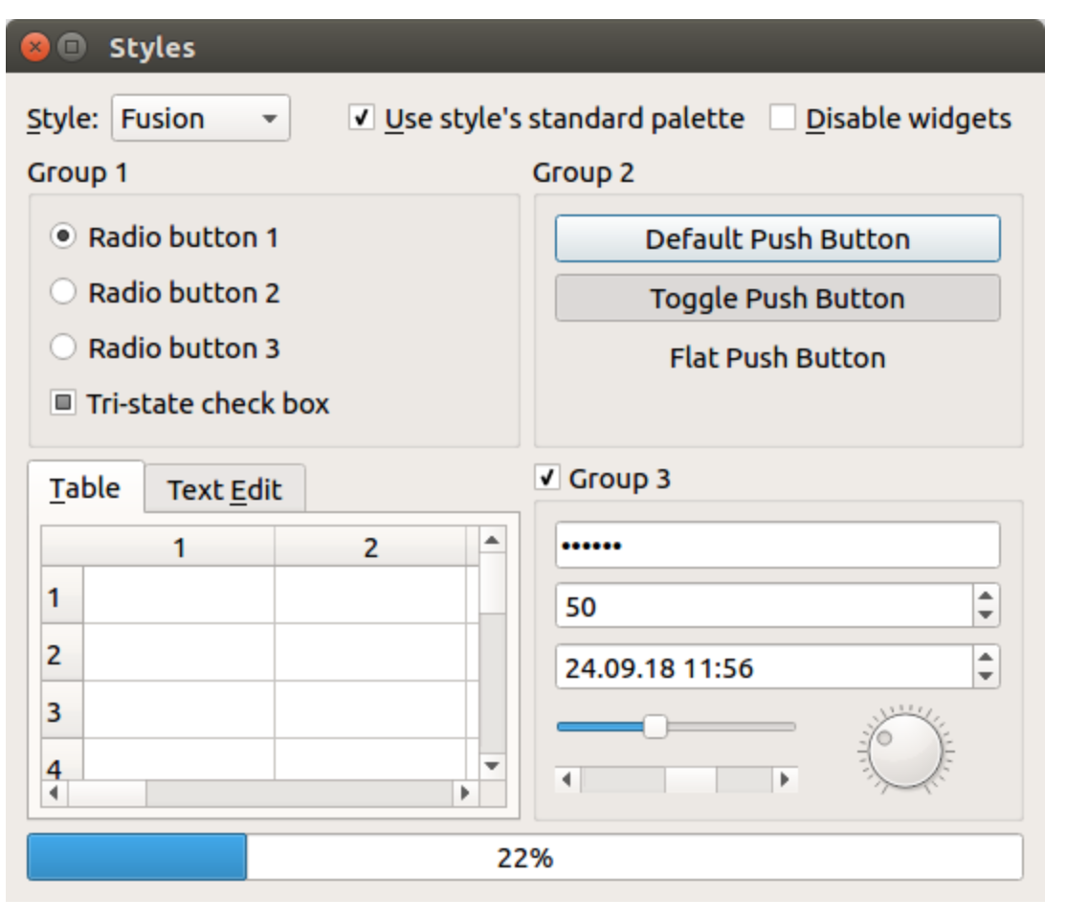
GUI Development
existing tools
PyQt
Qt is a set of cross-platform C++ libraries
PyQt5 is a set of Python bindings for Qt v5
Enables Python to be used as an alternative application development language to C++ on all supported platforms including IOS and Android
Common widgets: QLabel, QComboBox, QCheckBox, QPushButton, QSlider
Reference guide can be found here:
PyQt5 Documentation
*Must install first (Pip install PyQt5)

Slide 21
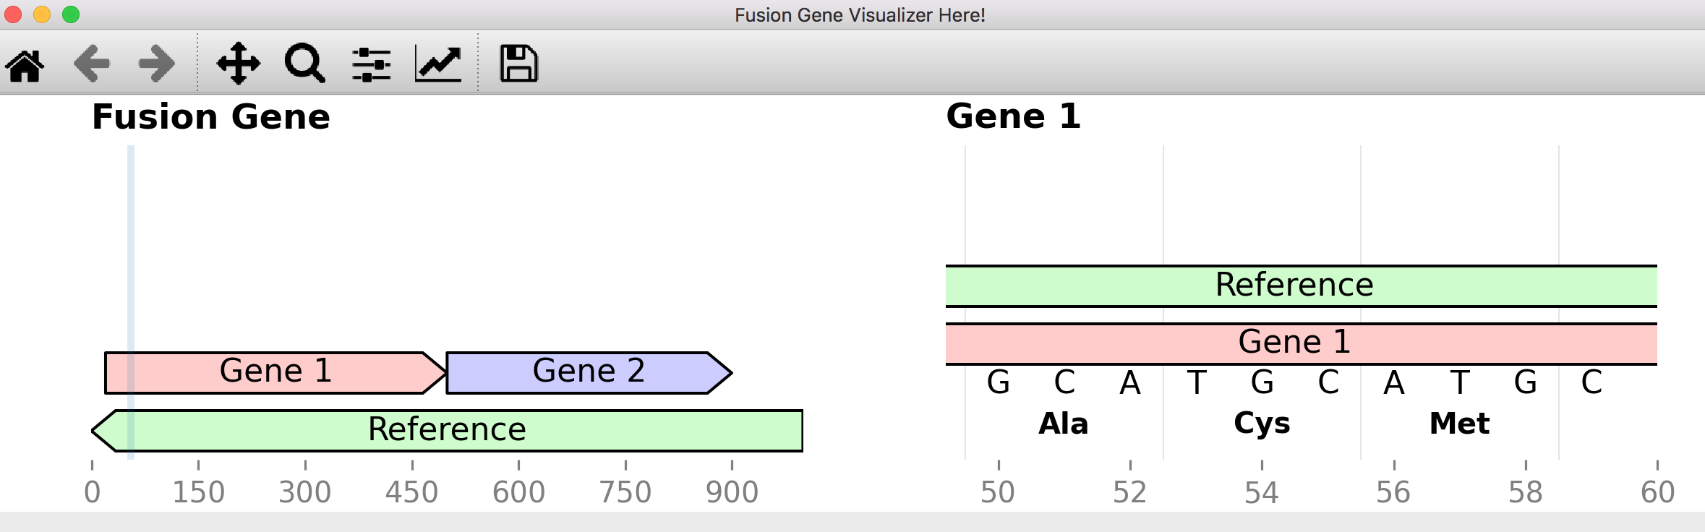
GUI Development
existing tools
DNA Features Viewer
Python library to visualize DNA features
GenBank, Gff files, BioPython SeqRecords
Produces simple and clear plots for sequence with many overlapping features
Could apply these to fusion genes
Can output to different formats: PNG, JPEG, SVG, PDF (Helpful for report generation, article figures, LIMS interfaces)
Reference code can be found here: https://github.com/Edinburgh-Genome-Foundry/DnaFeaturesViewer
*Must install first (Pip install dna_features_viewer)
Notes:
Used PyQt widget in this code
from PyQt5.QtWidgets import (
QWidget,
QApplication,
QMainWindow,
QVBoxLayout,
QScrollArea,

Slide 22
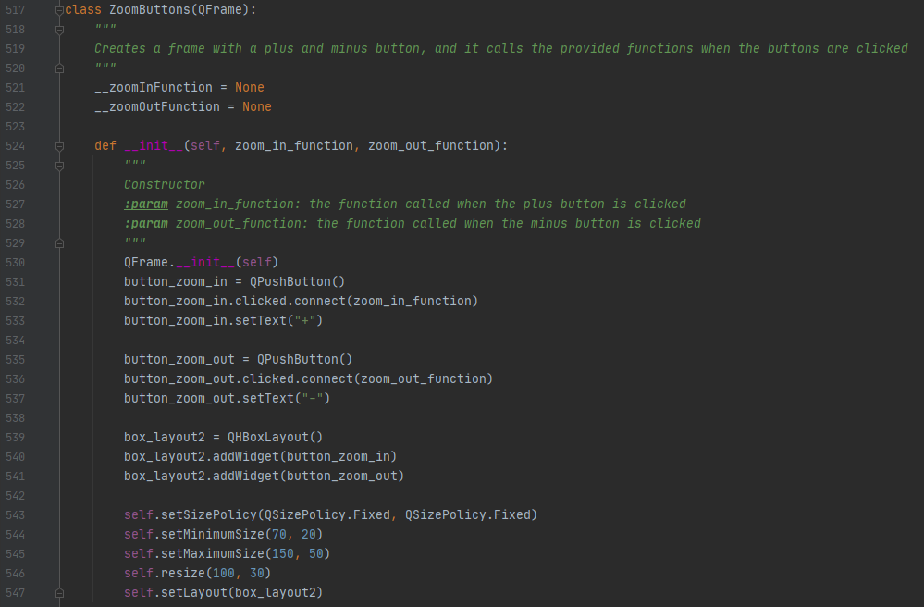
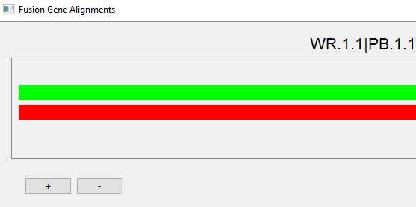
GUI Development
existing tools
PySide2
Provides access to the complete Qt5.12+ Framework
Used to create user interfaces in Python
Use Widgets to create the components of the GUI
This allows for user interaction in the display
Use Layouts to display elements nicely
Be sure to install PySide2 before running
Pip install PySide2
Reference code can be found here:
https://pypi.org/project/PySide2/
https://doc.qt.io/qtforpython/PySide2/QtGui/index.html

Slide 23
GUI Development
alignment_helper.py
Contains classes and functions to help with non-graphical processing and logic:
Provides the length and cigar type (ex. 16 M) (CigarEntry)
Converts the cigar sting to a list (cigarSringToList)
Removes the hard clip cigar entries from the front and back of the list (trimHardClips)
Provides the shaded areas (for drawing boxes) and padded sequences (for displaying next to boxes) (ShadedAreasInfo)
Takes the cigar list, defines the areas that should be shaded and create a padded read and reference string that lines up with the shaded areas (for display and graphical alignment) (cigarListToShadedAreas)
Based on the cigar string, can determine how many nucleotides we need to pull form the reference sequence (howLongShouldReferenceSequenceBe)
Contains information to draw one nucleotide sequence (HalfAlignmentInfo)
Contains information to show the comparison of two nucleotide sequences (AlignmentInfo)

Slide 24
GUI Development
alignment_helper.py
Def cigarListToShadedAreas(cigar_list, read_seq, ref_seq) - > ShadedAreasInfo:
Takes the list of class CigarEntry, rea_seq, and ref_seq and returns ShadedAreasInfo
ShadedAreasInfo contains four main functions
getShadedRef()
The area that would be shaded on the reference sequence
getShadedRead()
The area that would be shaded on the read sequence
getPaddedRefSeq()
Nucleotide sequence padded with whitespace where there should be gaps based on the cigar_list
getPaddedReadSeq()
Nucleotide sequence padded with whitespace where there should be gaps based on cigar_list

Slide 25
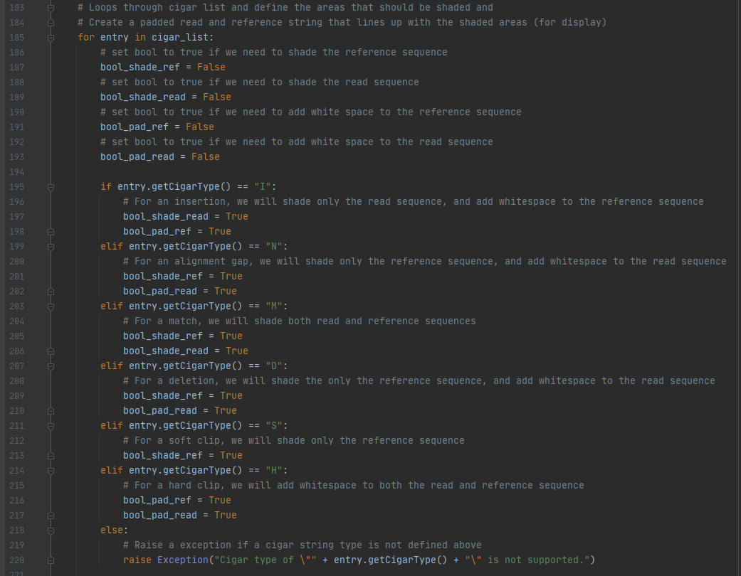
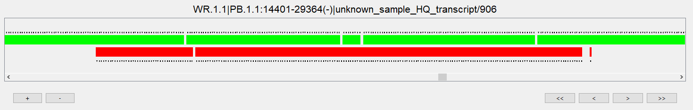
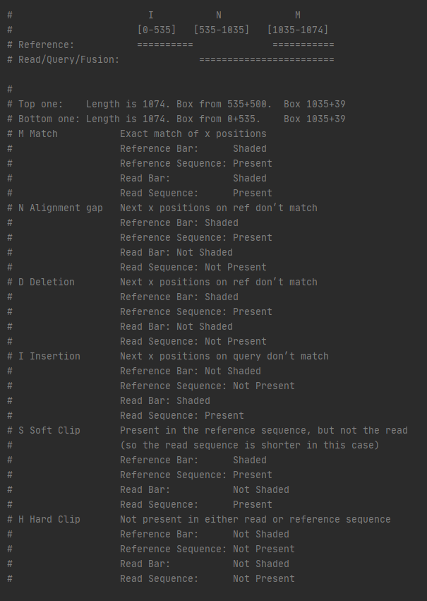
GUI Development
alignment_helper.py
Def cigarListToShadedAreas(cigar_list, read_seq, ref_seq) - > ShadedAreasInfo:
Logic used to determine how to display sequence based off of the cigar string

Slide 26
GUI Development
alignment_gui.py
Contains classes and definitions for components of gui building
Shows the nucleotide sequence in a QFrame and automatically adjusts the size of the sequence based off of the QFrame (NucleotideFrame)
Draws a single nucleotide alignment bar (typically two of these are used together) (BarFrame)
Will stack four items vertically (two nucleotide frames and two bar frames) (BarFrameStacker)
Contains a bar frame stacker and handles all zooming functionality (BarFrameStackerScrollArea)
Creates a frame with a plus and minus button, and calls the provided functions when the buttons are clicked (ZoomButtons)
Creates a frame with start, backward, forward, and end buttons, and calls the provided functions when the buttons are clicked (ScrollButtons)
Combines the BarFrameStackerScrollArea, the ZoomButtons, the ScrollButtons, and a title label (CompleteComparisonFrame)
Creates a QFrame that holds multiple CompleteComparisonFrames in a vertical box layout (CompleteComparisonFrameStacker)
Holds a CompleteComparisonFrameStacker in a QScrollArea (CompleteComparisonFrameStackerScrollArea)
Creates a window that displays multiple alignments (GraphTester)

Slide 27
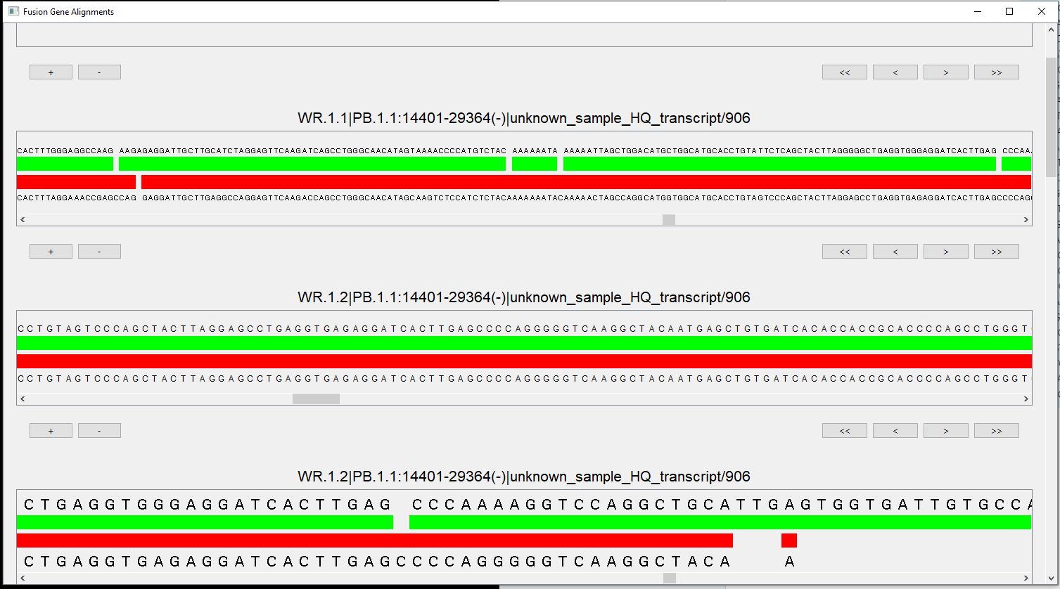
GUI Development
display

Slide 28
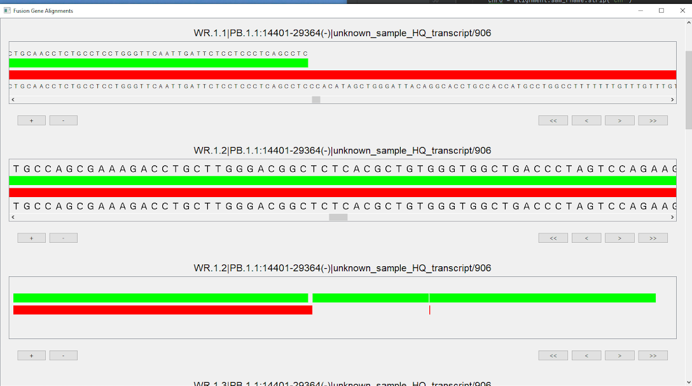
GUI Development
features
← Resizable Window
← Read Name
← Global Vertical Scroll Bar
Zoom Buttons →
*Can use mouse wheel or buttons to zoom or scroll
← Alignment Frame Scroll Bar
← Scroll Buttons

Slide 29
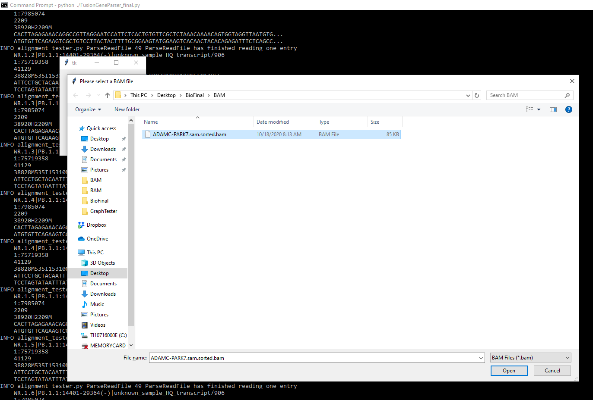
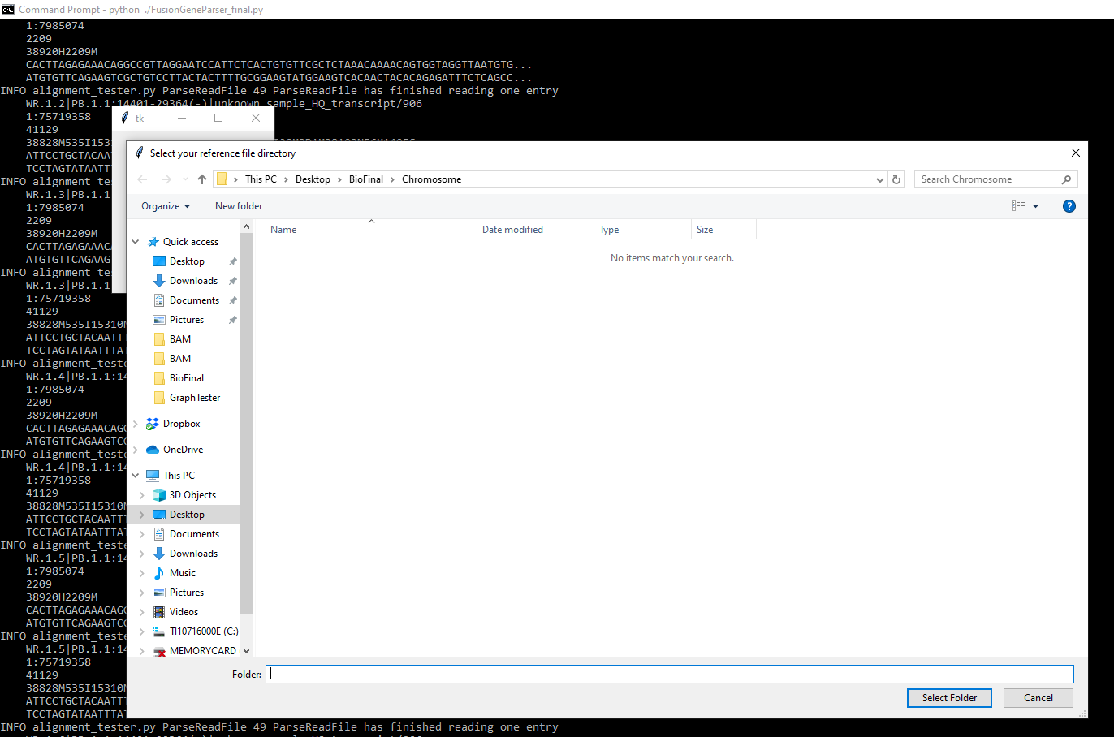
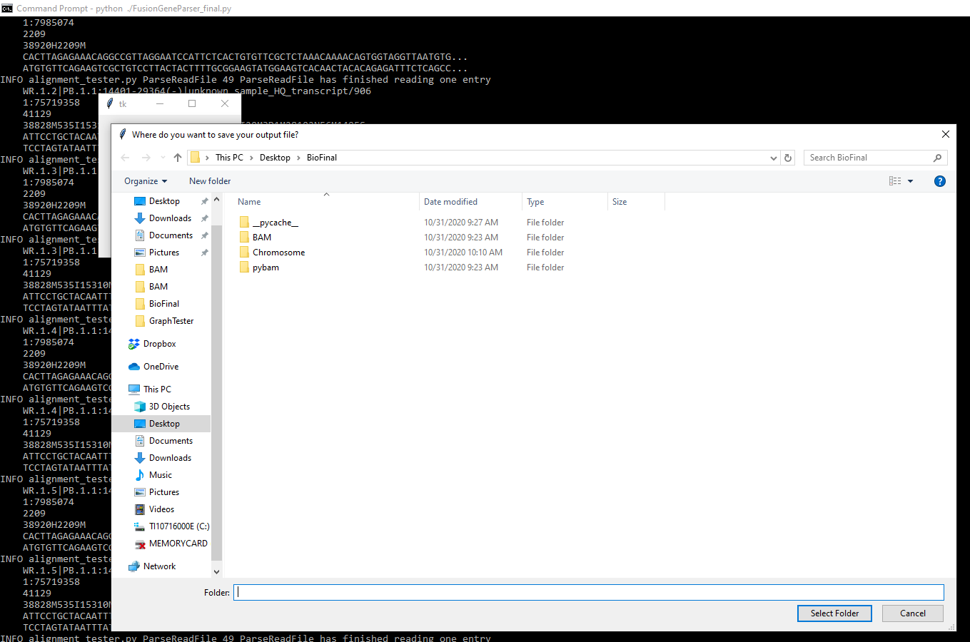
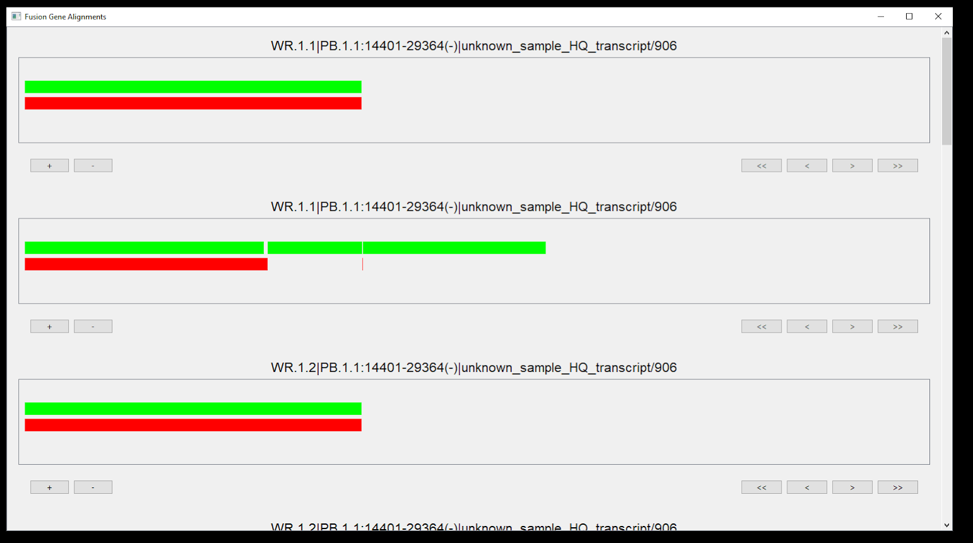
GUI Development
alignment_tester.py
Interfaces with the parser code
FusionGeneParser_final.py
Handles parsed data from FusionGeneParser (Parsedreads.txt)
Displays the alignment results

Slide 30
Future Considerations
gene annotation
In its current state, our GUI is able to display an aligned read and reference sequence with some zooming and scrolling capability. One key element which will need to be added is gene annotations for the chromosome locations displayed. The BAM file only includes information about the alignment, and the reference sequence FASTA is a simple text file, so these annotations would need to come from a third source. There are multiple tools available which might be useful for this application. One is python package pyensembl. (https://pypi.org/project/pyensembl/0.5.4/)
This package includes a variety of functions related to gene locations, transcripts, and exons. For example:
genes_at_locus(contig, position, end=None, strand=None) : returns list of Gene objects overlapping a particular position on a contig, optionally extend into a range with the end parameter and restrict to forward or backward strand by passing strand='+' or strand='-'.
gene_names_at_locus(contig, position, end=None, strand=None) : names of genes overlapping with the given locus (returns a list to account for overlapping genes)
These functions offer a way to return Gene annotations based on defined chromosome location.

Slide 31
Future Considerations
breakpoints and read depth
Because our GUI is still under development, it currently displays single read and reference sequence (sample data) in each window pane, which is useful for establishing initial display parameters. However, BAM files often contain hundred, if not thousands of reads, so displaying each read individually does not adequately address the application. Some suggestions regarding this include:
Identical reads can be grouped such that the count is displayed (read depth) along with one copy of the read
Reads can be grouped by breakpoint. Many times, when a fusion gene is detected, more than one breakpoint will be present
Each breakpoint group can be displayed in its own pane within the visualizer window
Vertical and horizontal scrolling can be enabled within each breakpoint window
Breakpoint 1
Reference
Gene 1
Gene 2
Gene 1
Gene 2
Gene 1
Gene 2
Breakpoint 2
Reference
Gene 1
Gene 2
Gene 1
Gene 2
Gene 1
Gene 2

Slide 32
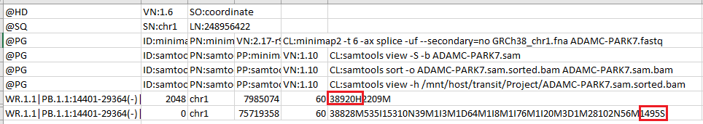
Future Considerations
fusion reads
One issue we encountered with the sample BAM files provided for this project was that even though the presence of supplementary alignments was annotated where applicable, a full read sequence containing both alignments was not present. (ie - no read sequences containing both fusion partners) Further investigation of a sample BAM file with known fusion transcripts revealed the presence of hard and soft clippings, as indicated by the cigar string.
Such phenomenons are a characteristic of the aligner used for BAM file generation. For this particular application, it would be ideal to disable any functions that trim the sequence included in the alignment record.

Slide 33
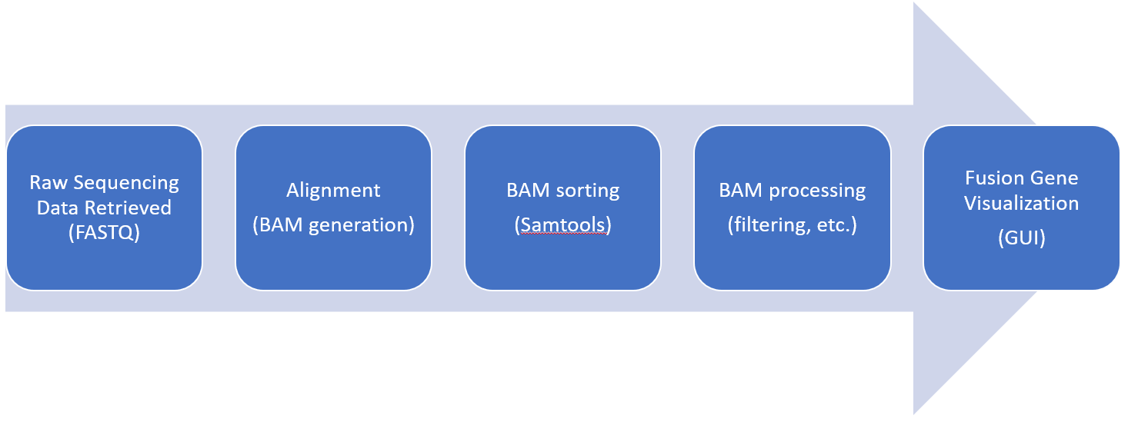
Future Considerations
final product
Our current code is successful in filtering reads and displaying alignments, but we have not yet tackled the display of an actual fusion read sequence. Considering the issue we encountered with hard/soft clippings, it might be useful to expand the project such that a raw data input is used initially. This could address the problem by allowing for standardization of aligner settings, reference genome, and BAM sorting.
Ideally, a raw data file (FASTQ, FAST5, etc.) could be imported, aligned to create a BAM, sorted, parsed, and displayed.

Slide 34
References:
User jkbonfield. (2020, May). Sequence Alignment/Map Optional Fields Specification. SAMtools repository. https://github.com/samtools/hts-specs/blob/master/SAMtags.pdf
User JohnLonginotto. (2019, February). PyBam. Github Repository.
https://github.com/JohnLonginotto/pybam
Kim, P., Yiya, K., Zhou, X. (2020). FGviewer: an online visualization tool for functional features of human fusion genes, Nucleic Acids Research, 48( W1), W313 - W320. https://doi.org/10.1093/nar/gkaa364
Shipman, J. W. (2013). Tkinter 8.4 reference: a GUI for Python. New Mexico Tech Computer Center. Retrieved from: http://alexandre.benoit.83.free.fr/archives/1415/adumas/ISN/tkinter.pdf
Schmidt, B. M., Davidson, N. M., Hawkins, A.D.K., Bartolo, R., Majewski, I. J., Ekert, P. G., Oshlack, A. (2018). Clinker: visualizing fusion genes detected in RNA-seq data, GigaScience, 7(7), giy079. https://doi.org/10.1093/gigascience/giy079
Summerfield, M. (2007). Rapid GUI Programming with Python and Qt: The Definitive Guide to PyQt Programming (paperback). Pearson Education.
Zhang, J., Gao, T. & Maher, C. A. (2017). INTEGRATE-Vis: a tool for comprehensive gene fusion visualization. Sci Rep 7, 17808. https://doi.org/10.1038/s41598-017-18257-2

